Slide 1
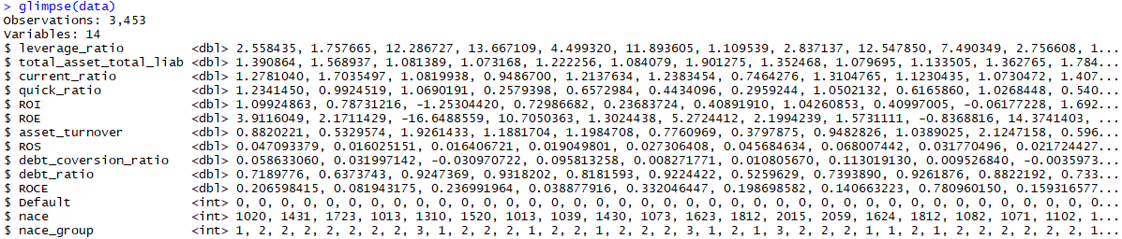
Data Introduction
Given data: the data are listed as small companies. And the sample include 3453 observation, come along with 14 variables. Most of the variable are financial indicators, except the NACE and NACE group which describe the manufacture industrial of the company.
Target: to build a suitable model that can predict whether a company is default.
Method: as the predicted data is Default or not ( Binary factor 0,1) so this is supervised learning and a classification problem. So I decided to use Logistic regression, Random forest, Classification tree.

Slide 2
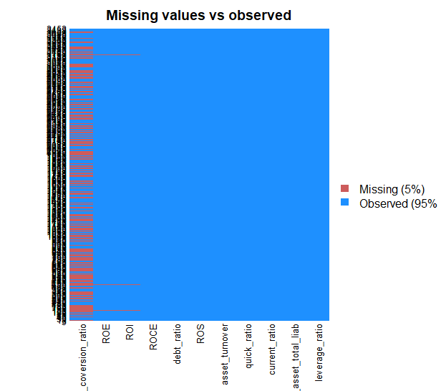
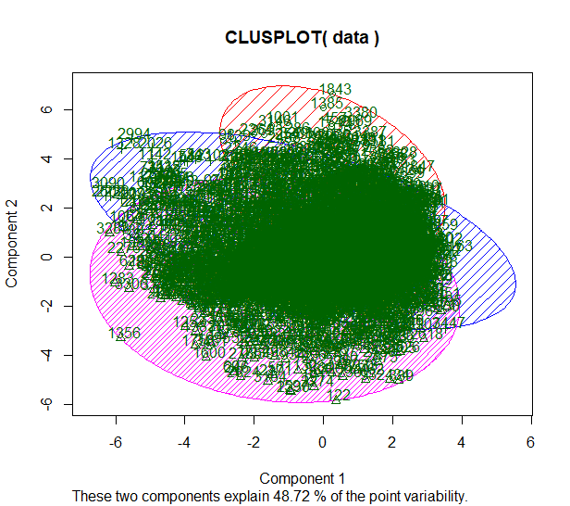
Data summary
The data include 14 variables with 3542 observations. In which there are some missing value in three columns which are: ROI, ROE, and debt_conversion_ratio. And as these missing data seem to be missing at random ( MAR), so the missing variable could be filled in rely on the KNN method which absolutely provided less bias than filling by mean method.

Slide 3

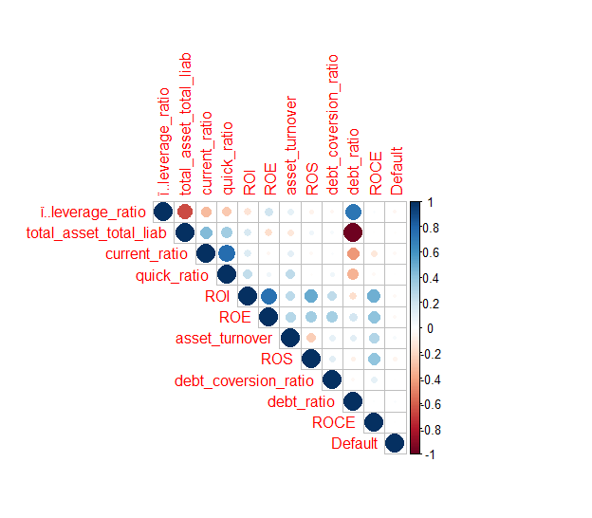
Data manipulate
The data firstly filled in NA value by Knn imputation as this method is more effective than normal mean method. And the result is also tell that when I compare with mean method, the accuracy rate increase around 2-3% in different case
Moreover, as our target is to predict the Default variable, the nace group and nace just tell us the industrial in which the companies is working in, and from the previous cluster plot, we rarely can divided these data into exact group, so i decided to delete these two variable, NACE and NACE group as it could lead to some misunderstanding in the model. And also from the correlation matrix we can easily that debt_ratio and totalasset / totallib correaltion is exactly -1. This can be reason as the total_asset_total_lib = 1/debt_ratio. So we only keep one out of two these variables. I decided to delete the debt_ratio column. Lastly, we will have 11 variable which will be used to analyzed the default.

Slide 4
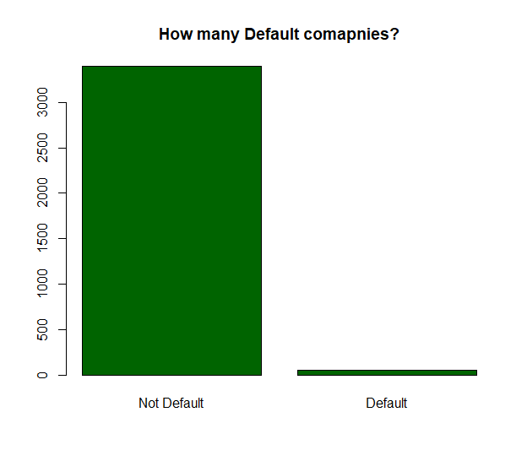
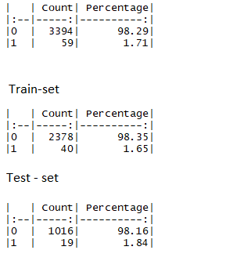
Sampling split test
As our target is to maximize the accuracy rate because it’s useless to just predict base on the sample, so firstly we have to split the data in to test set and training set with the proportion 70-30. To reduce the overfitting and the random effect, I also try to apply K-fold 5, 10 repeated times for the logistic regression method.
The data are divided as followed :

Slide 5
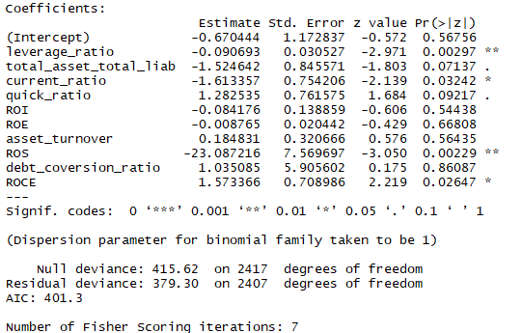
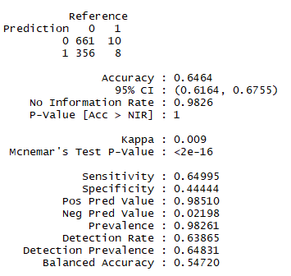
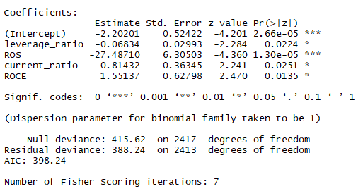
Logistic regression
Starting with the logistic regression method, there only 4 variable that have significant. I afterwards check Wald test to see whether revoming the variable will harm to the result, and all the p-value of the test are high so we can reject the null hypothesis that removing these variable will createproblem for the prediction model

Slide 6
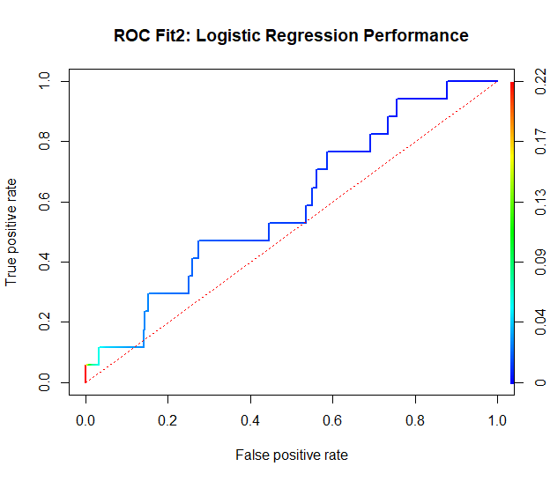
Logistic regression result
Split 70-30 | K-fold = 5 (repeated 10 times) | LOOCV
64,64% | 67,86% | 68,71%
Coming with ROC plot, we can recognized that the model is just a little bit better than the random lines as with the accuracy rate 64,64% is model is just average. But when look at the coefficient in which ROS is too high ( 27.5) compare to the other which roundly less than 1. So we can reduce the overfitting problem in this case by using regularization method like Lasso or Ridge regression.

Slide 7
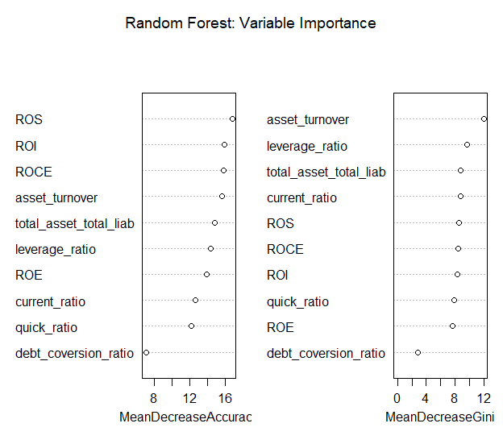
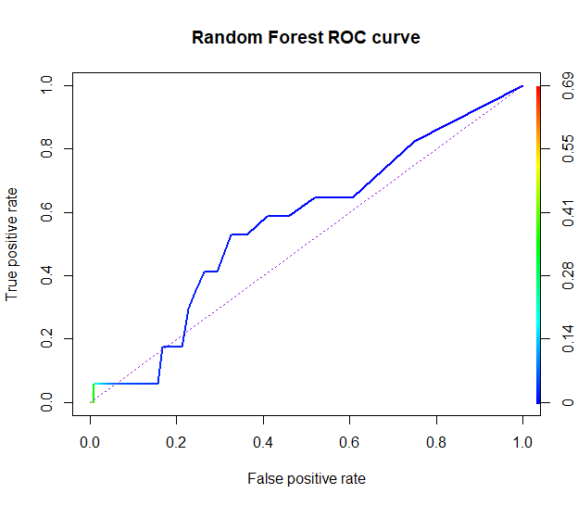
Random Forest
Here I continue with random forest. And i firstly check the importance of variable to see whether we need to remove some. As can be seen, all the variable did not vary so much so it’s not needed to set a threshold and can use all the variable. The ROC curve told that the model is just a little bit better than the random line in which it just very similar to the logistic regression model.

Slide 8
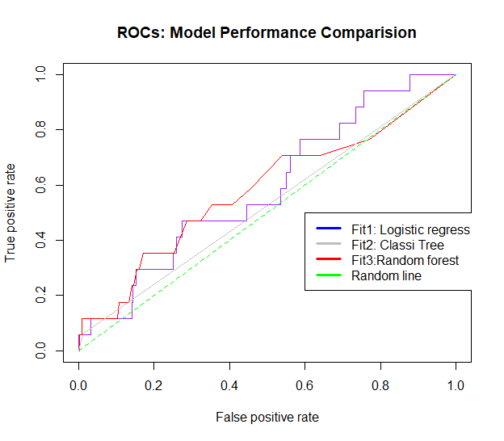
This plot will compare all the method we used to analyzed. As can be seen that logistic regression dominate the other method although all of these result are just average prediction meaning a little bit better than the random line which is 50%. Coming together with the easy to interpret, in this case, logistic regression will be choose to determine whether a company is default or not

Slide 9
Conclusion
In conclusion, in my opinion these model are not so good but just average as the accuracy rate is not so high. Both random forest perform quite similar at around 65%. Yet, logistic regression is much more easier to interpret.
This study may have some value in real life especially for some one who work as a financial analysis or bank. When we have a lot of data these model can easily decide the default of somebody or a company and we can decide the credit rating for them.
Leverage measures the size of Average Total Assets relative to Average Total Common Equity. It is one of the standard indicators implied by the structural approach to the pricing of default risk. Higher leverage (lower capitalization) would correlate positively with default risk.
And in all the case when i test several time with random sample or K-fold, the variable leverage ratio always have very p-value. Consquently this variable should be analyzed carefully when we need to assess a company default or not

